Slide 1

“Secure Access”
Department of Computer Science and Engineering
Engineering College Ajmer
Mentor : Mrs. Bhanupriya Sharma

Slide 2

🔐 Secure Access – Project Architecture & Technologies
This presentation outlines the architecture and technologies behind our secure access project. We will cover system monitoring, web security, and data protection. Join us to explore the building blocks of a robust security system!

Slide 3
TEAM MEMBERS
Musraf Khan (22EEACY033)
Darshanpal Singh (22EEACY017)
Arvind Singh Rathore(22EEACY009)
Aryan Nawal (22EEACY010)
Ankur Choudhary (22EEACY006)
Divesh (22EEACY019)

Slide 4

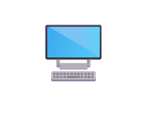



Overview 📌: Secure Access System
System Monitoring
Real-time insights into system performance.
Web Security
Advanced filtering and protection mechanisms.
Application Shielding
Fortifying applications against threats.
Data Protection
Guarding sensitive information effectively.

Slide 5
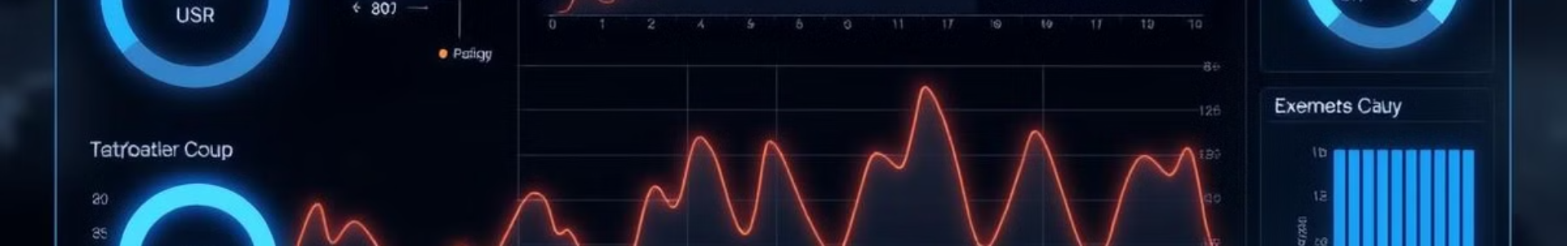
🖥️ System Monitoring: Real-time Insights
CPU Usage
1
Tracked every second.
2
Memory Usage
Monitors RAM consumption.
Network Activity
3
Detects anomalies in traffic.
4
Disk I/O
Identifies hardware issues.

Slide 6





🌐 Web Security: Filtering & Protection
URL Filtering
Content Filtering
SSL/TLS Inspection
Anti-Phishing

Slide 7
🔒 Application Shielding: Fortifying Apps
Runtime Monitoring
Input Validation
Privilege Management
Monitors application behavior.
Prevents injection attacks.
Enforces least-privilege.

Slide 8
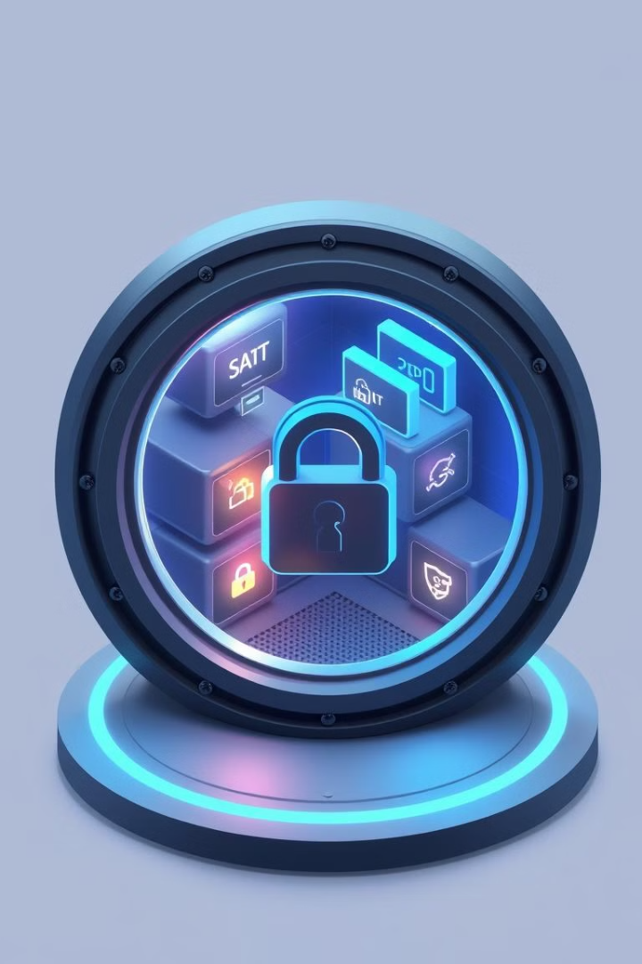



📁 Data Protection: Guarding Sensitive Information
Encryption
Hashing.
Access Control
Role-based access (RBAC).
Data Loss Prevention
Detects sensitive data leaks.

Slide 9
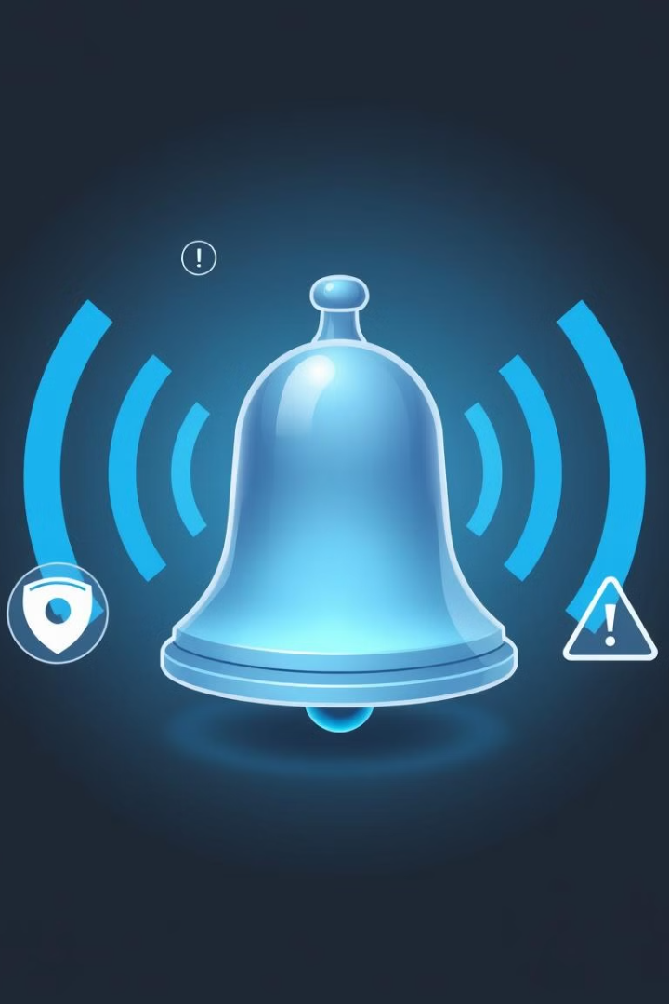
📢 Alerts & Settings: Configuration & Notifications
Customizable Alerts
Notification Channels
Define event thresholds.
Email, SMS, push notifications.
Configuration Management
Easy deployment and updates.

Slide 10



⚙️ Technologies Used in Backend
Flask
2
Cross-platform GUI toolkit.
Python 3.12
1
Versatile and easy to use.
Security Libraries
3
PyCryptodome, Scapy , haslib , psutil ,ssl

Slide 11
⚙️ Technologies Used in Frontend
JavaScript
2
Html
1
CSS
3

Slide 12



Project Architecture: Modular Design
1
UI Module
2
Security Module
3
Monitoring Module

Slide 13

Conclusion & Future Enhancements
Cloud Threat Feeds
Integration Of Cybersecurity Tools
Automated Response
Implement Sandbox Environment For APK Analysis

